Slide 1
2020 tweets analysis

Slide 2
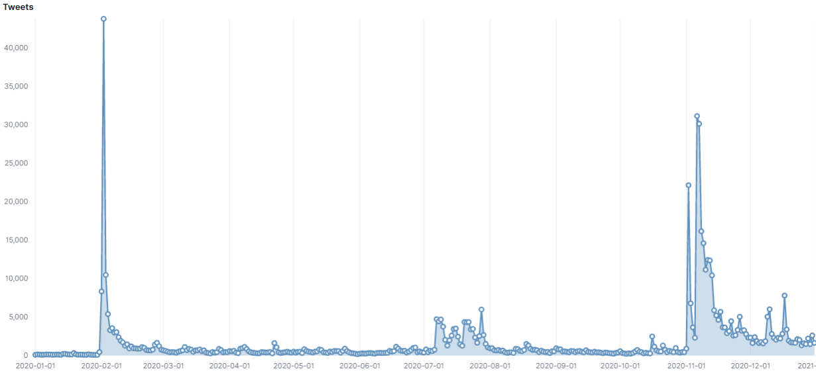
Peaks of tweets against Amber

Slide 3
Analyzed the 2 days with highest peaks

Slide 4
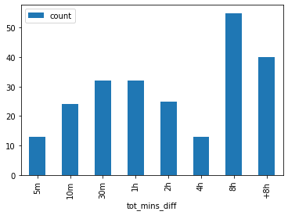
02/02/2020
122 out of 240 accounts tweeted the same day of their creation.
69 accounts tweeted within 30 minutes since their creation.
126 accounts tweeted within 2 hours since their creation.

Slide 5
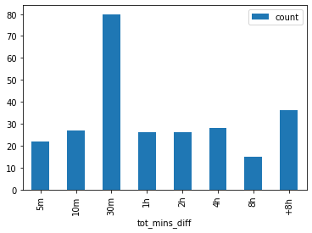
07/11/2020
101 out of 255 accounts tweeted the same day of their creation.
129 accounts tweeted within 30 minutes since their creation
181 accounts tweeted within 2 hours since their creation

Slide 6
Topic-based account groups
Using Google’s Universal Sentence Encoder which encodes text into high dimensional vectors, I’ve analyzed topics shared by accounts each month during 2020. To do that, I’ve used UMAP for non-linear dimension reduction, then I’ve clustered similar tweets through HDBCAN.
Next, I generated a network of co-occurrences for the accounts that appeared in the same clusters. I applied a community detection algorithm to the resulting network, in this case Leiden to find clusters of accounts that shared tweets on the same topic.
I have reported the most interesting months.

Slide 7
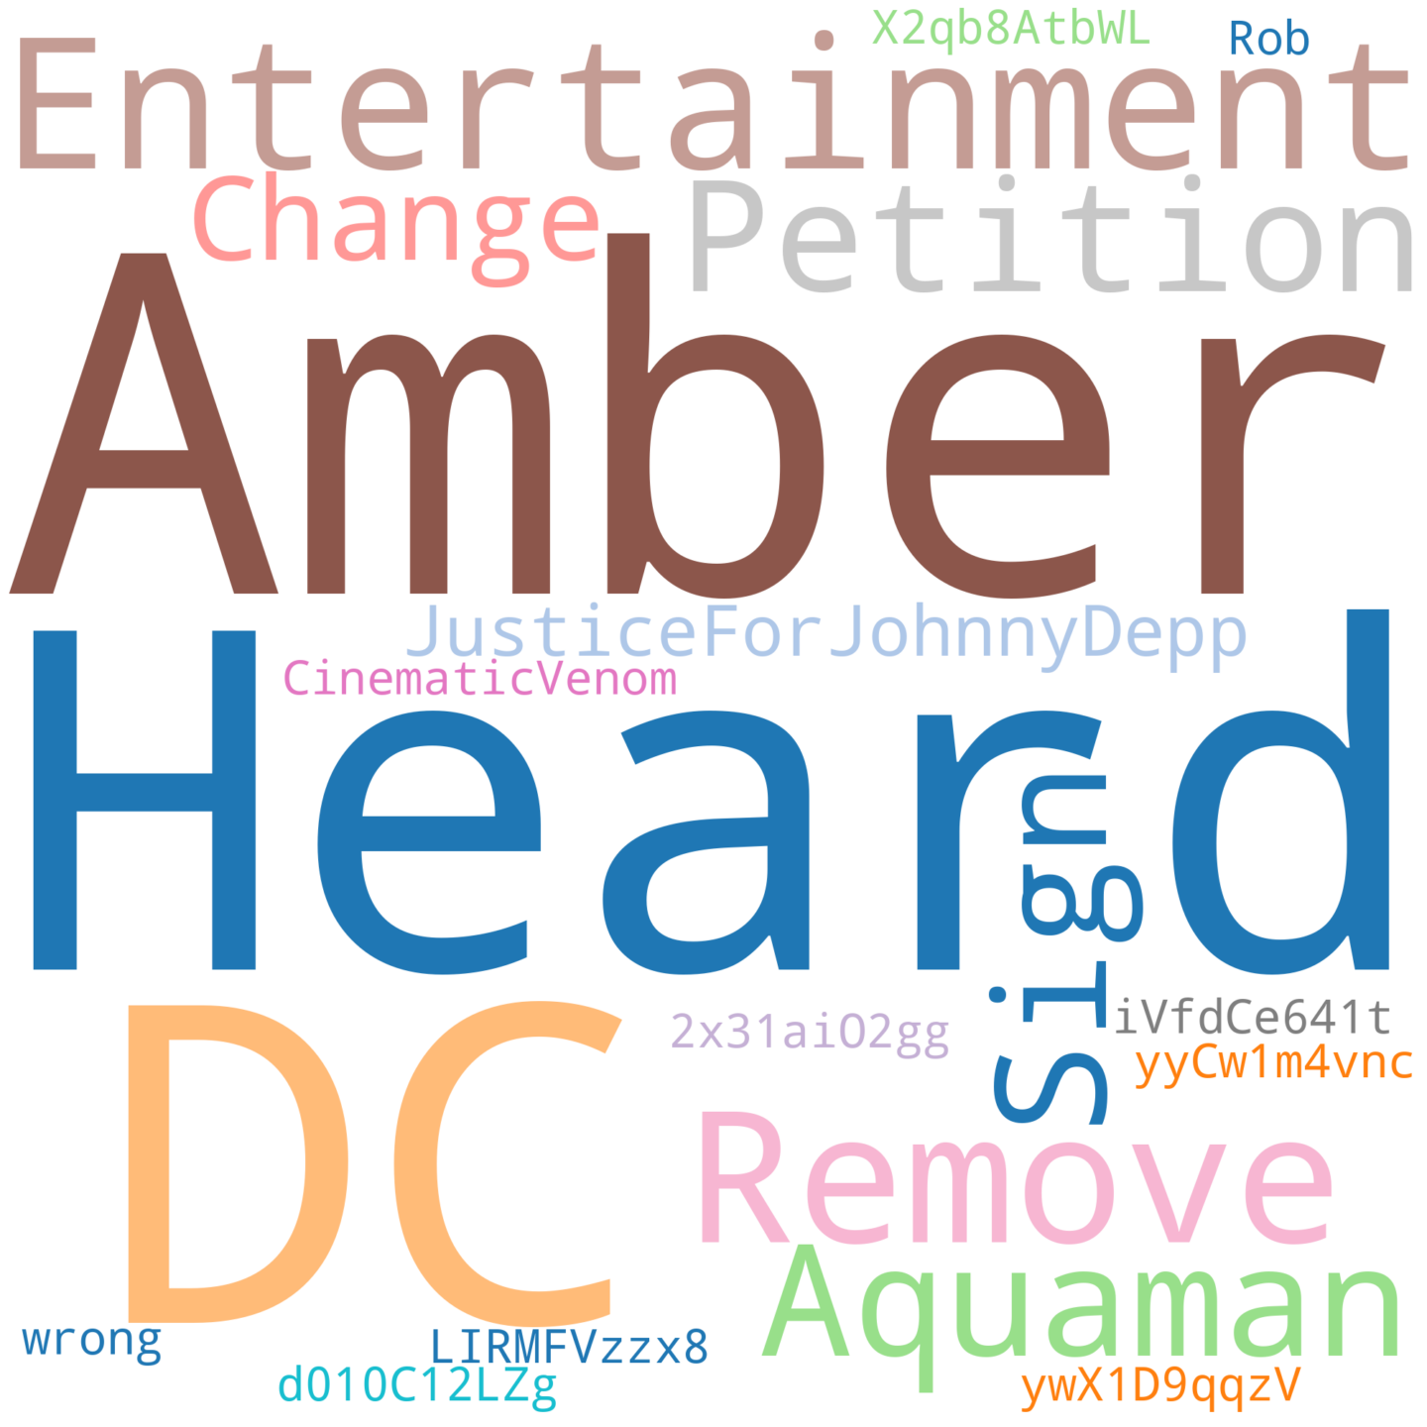

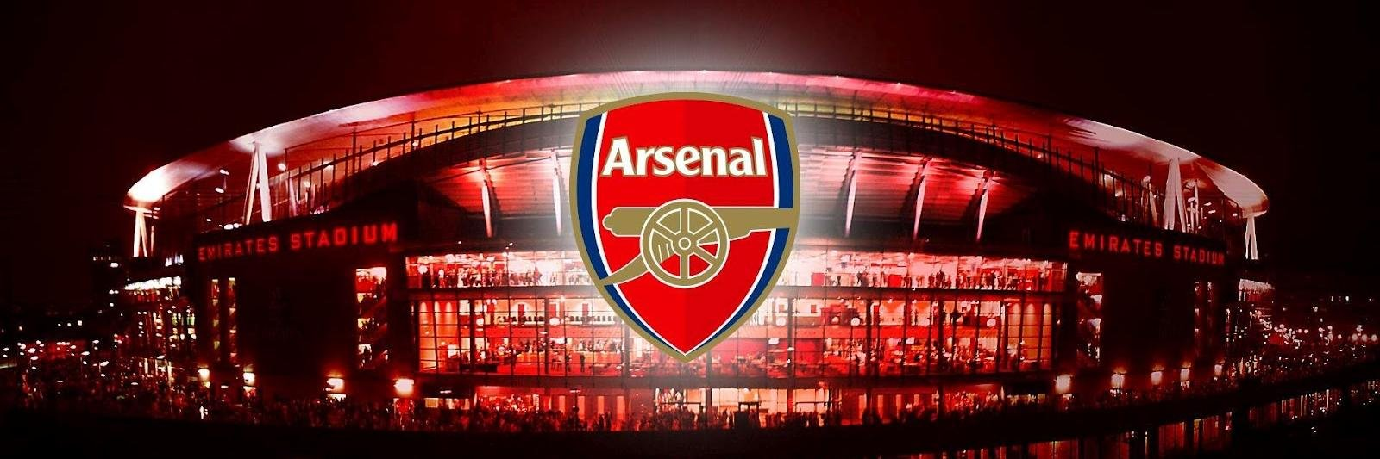
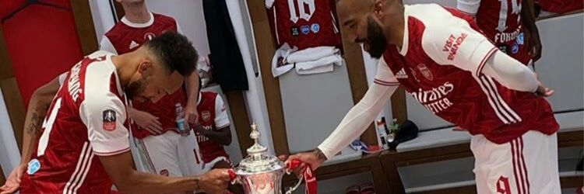
Arsenal network
(February)
Most of the groups of accounts have expressed their desire not to see Amber in the upcoming Aquaman sequel.
Users belonging to one of these groups, however, show similarities, in this case about 30 users have a picture of the Arsenal team as their banner image.

Slide 8
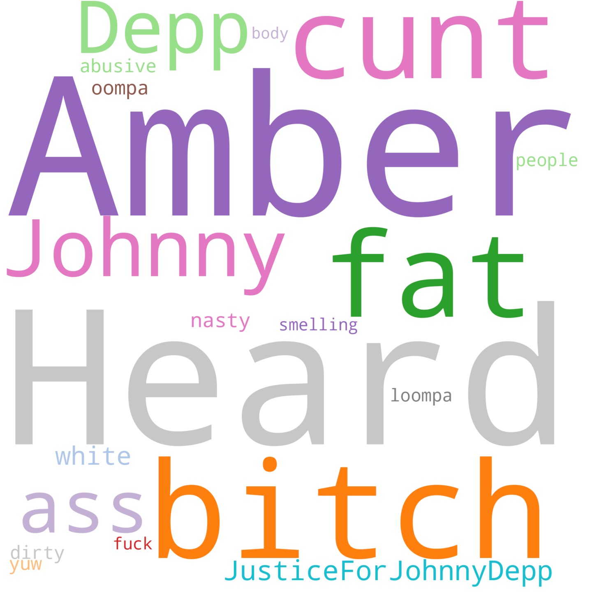
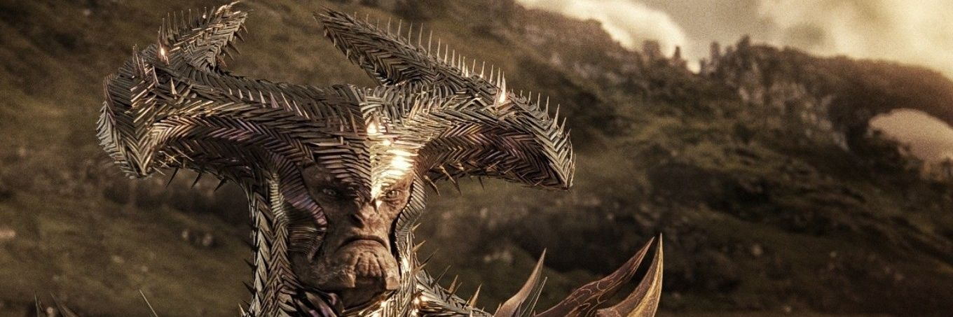
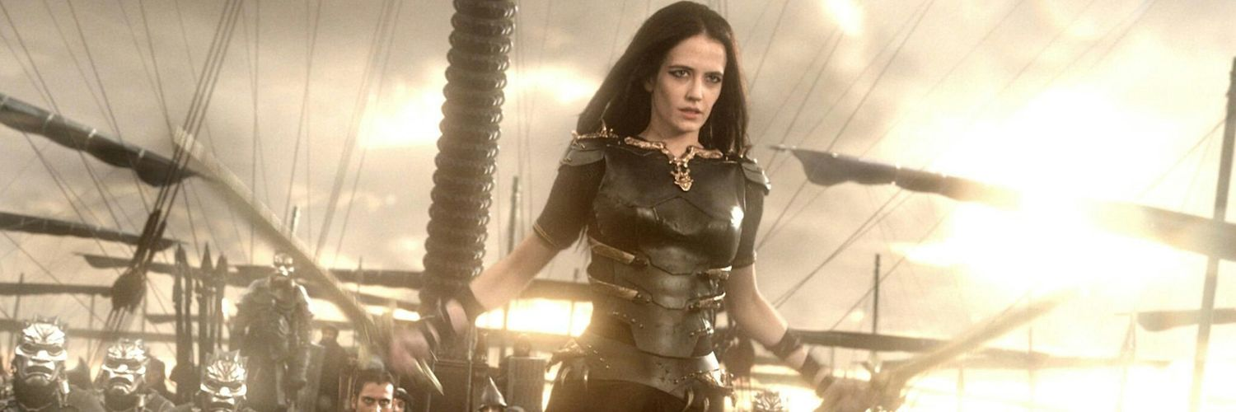
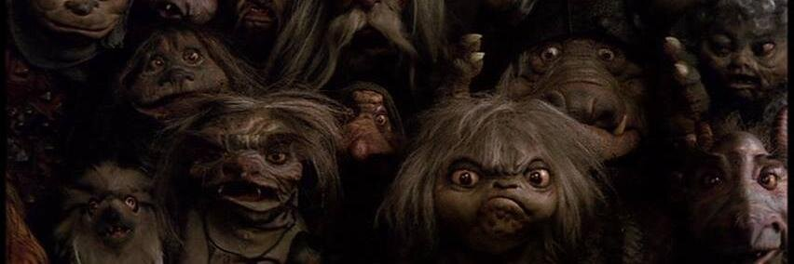
Movies network
(February)
This group stands out from the others because instead of focusing on the events, they just tweeted to offend Amber.
What's suspicious is that all 35 or so accounts have a picture from a movie as their banner image, mostly from DC.

Slide 9
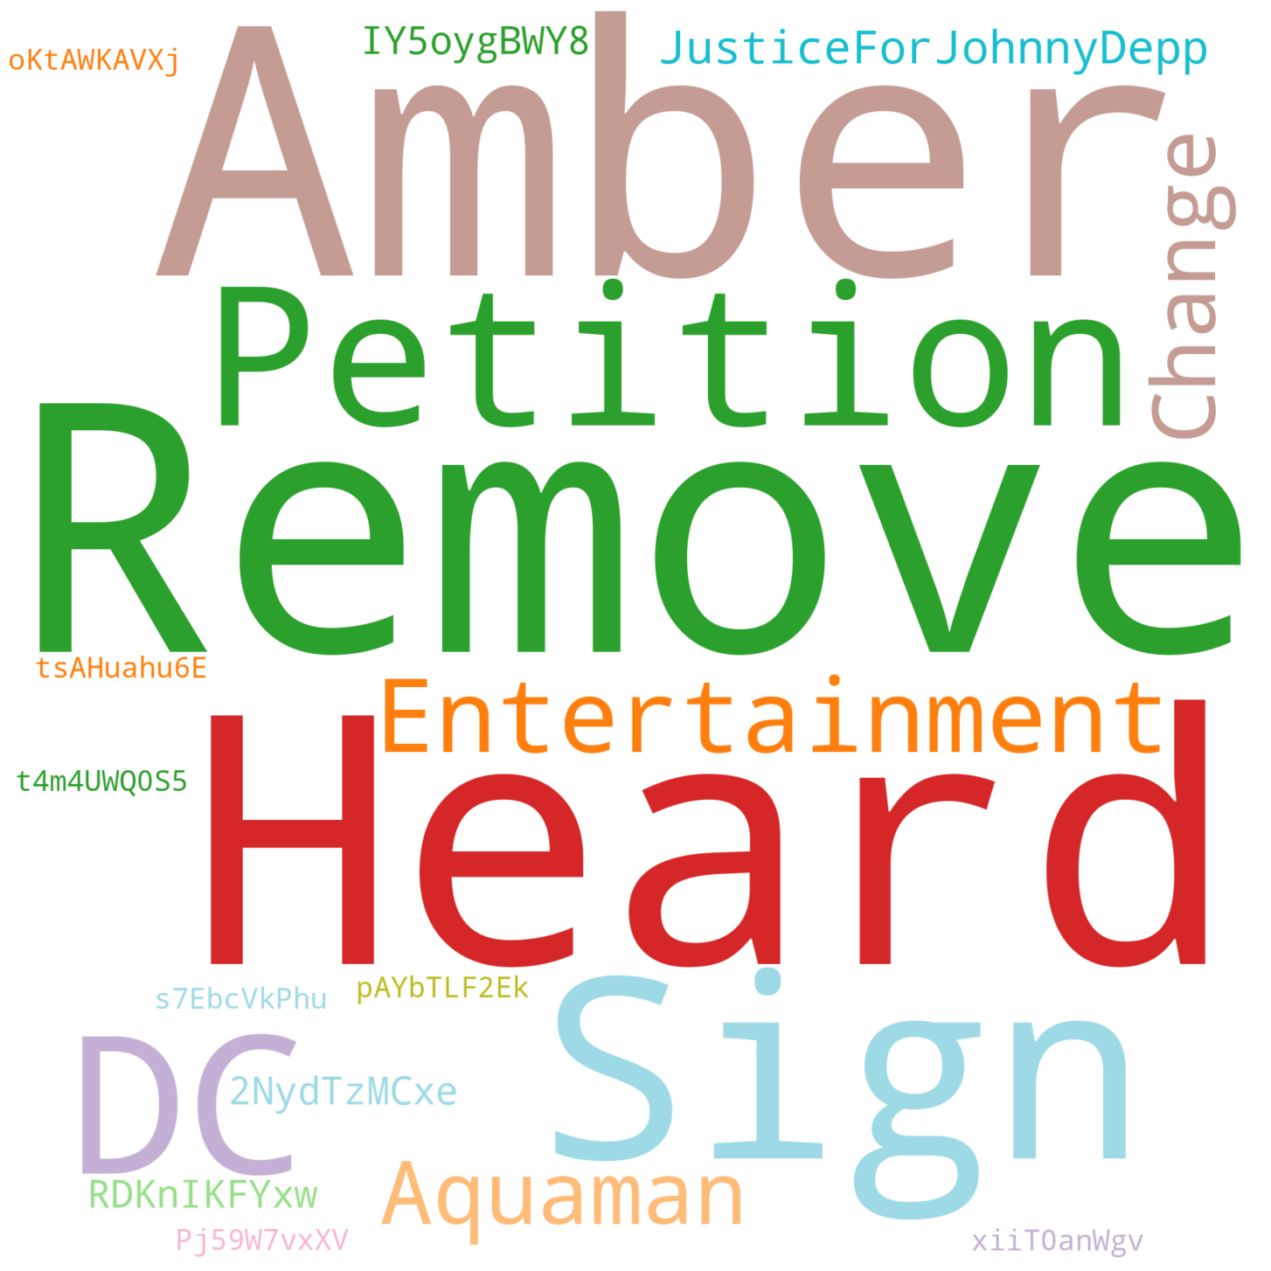
Mentions network
(November)
This group of 60 accounts in addition to the most used keywords and hashtags, shared words that didn't seem to make sense.
These are probably mentions to accounts, which anyway have very unusual screen_names: tsAHuahu6E, t4m4UWQ0S5 etc..

Slide 10
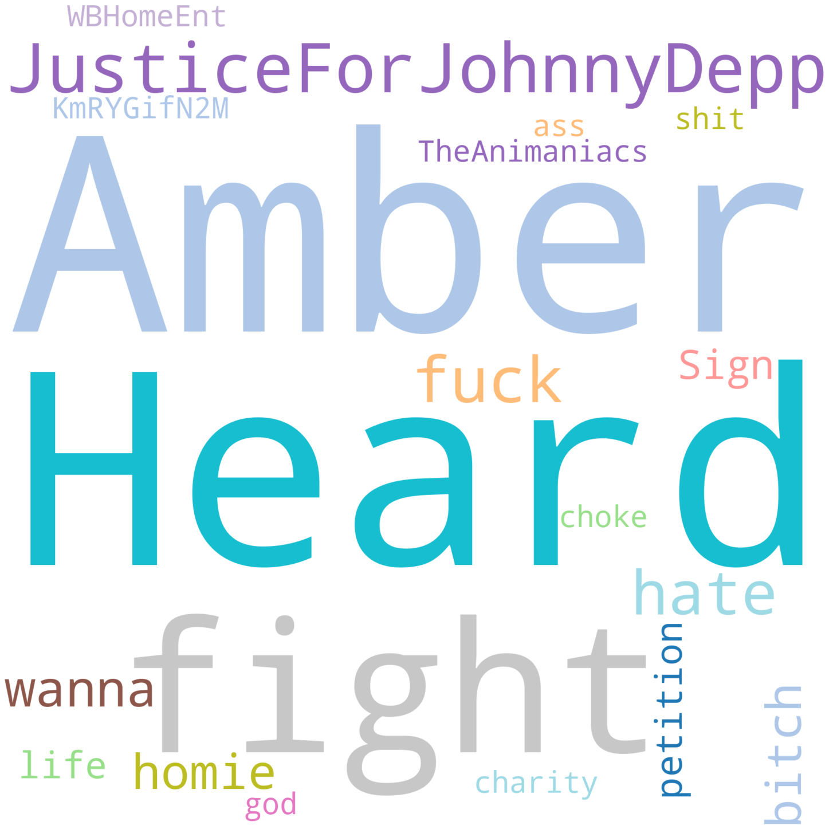
Mentions network (part 2)
(November)
Similar to the previous group, this group of 50 accounts also shared meaningless keywords.

Slide 11
Future developments
As of now, these are preliminary results as it is a very large dataset (660K tweets).
However, these results show us what paths we can take to find and identify any botnets that may exist within it.
For example, use an image classifier to find a correlation between tweet semantics and profile/banner images, as botnets often identify themselves on a particular topic (e.g. Arsenal fan accounts)

